Slide 1
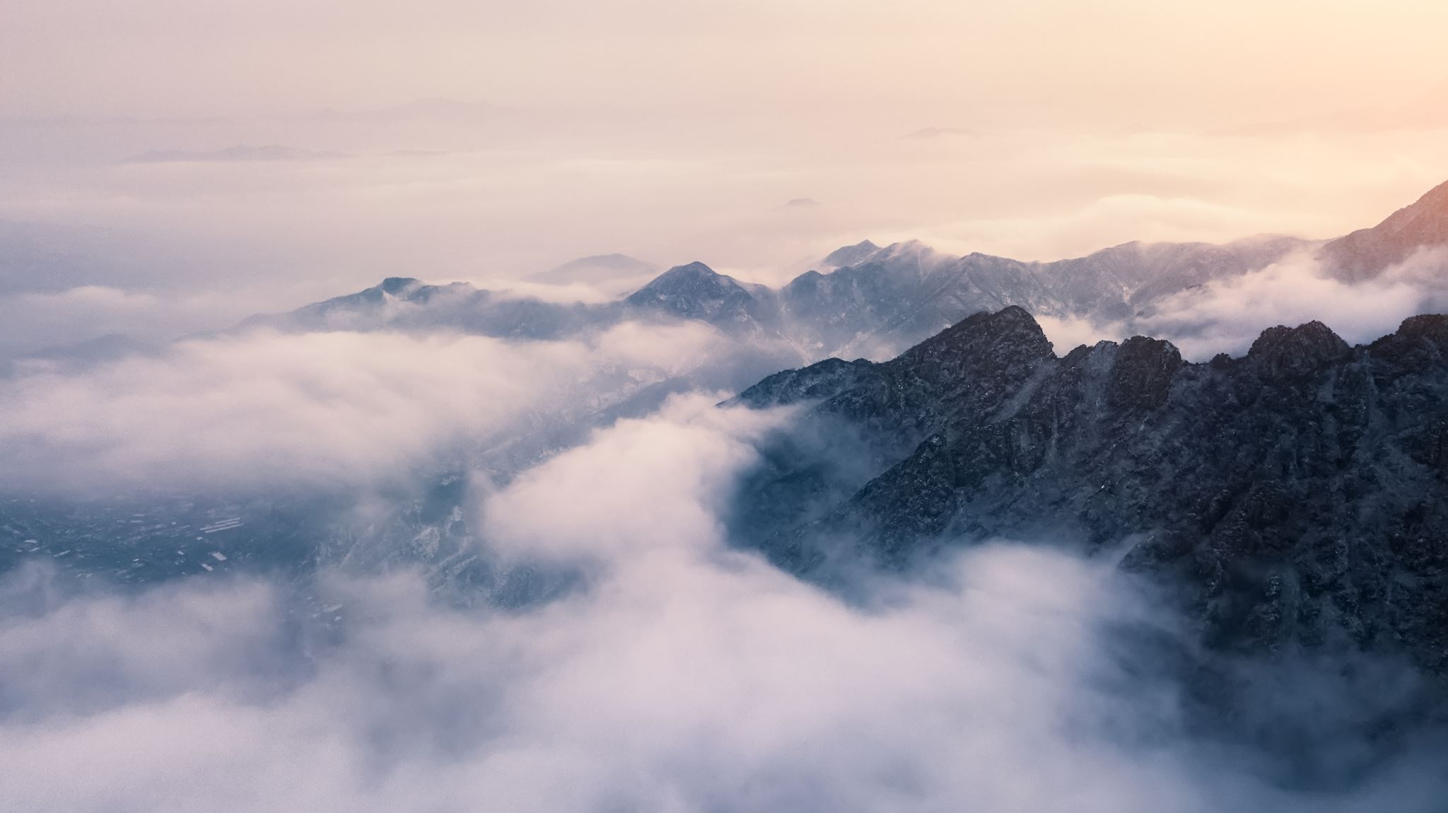
Suspense Stories…

Slide 2
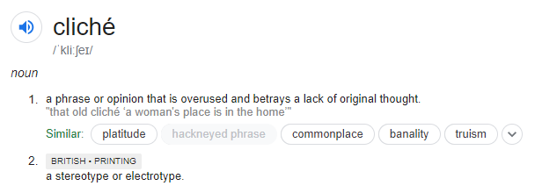
Can you think of any clichés in terms of mystery, horror or suspense stories?
Example: “it was a dark and stormy night”
Let’s split up and look for clues
Mysterious stranger
Someone going down to the basement
Forest or wooded area

Slide 3
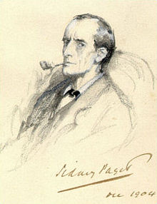
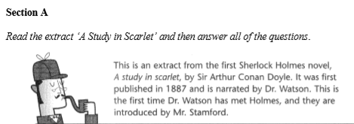
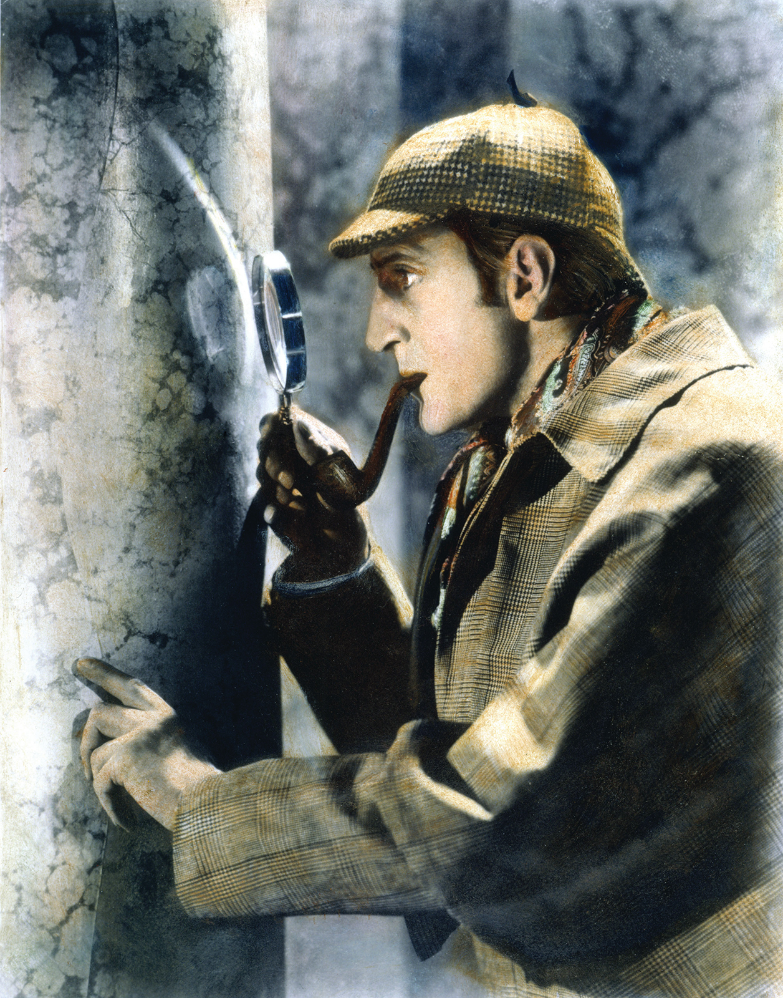
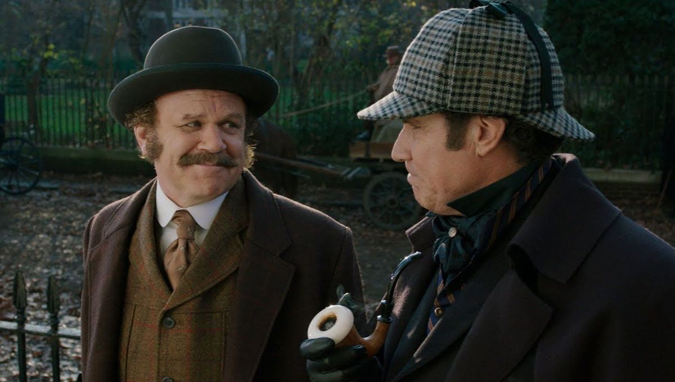
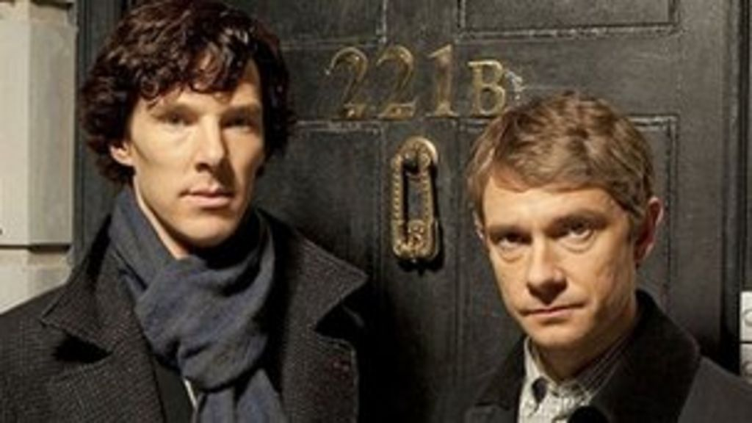
Sherlock Holmes:
He is the fictional but brilliant detective created by Arthur Conan Doyle in 1887, created for the novel A Study In Scarlet, published in Beeton’s Christmas Annual.
Sherlock Holmes has essentially an obsessive personality. He works compulsively on all his cases and his deductive powers are phenomenal. He has an in depth knowledge of music and plays on a Stradivarius that he bought for a song in Tottenham. He is also known to run chemistry experiments in his spare time to the dismay of both Dr. Watson and his landlady Mrs. Hudson.

Slide 4
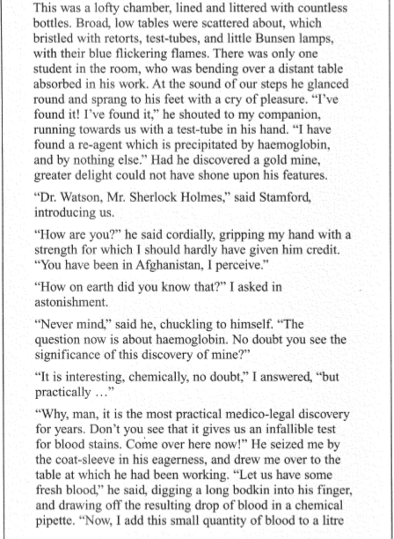
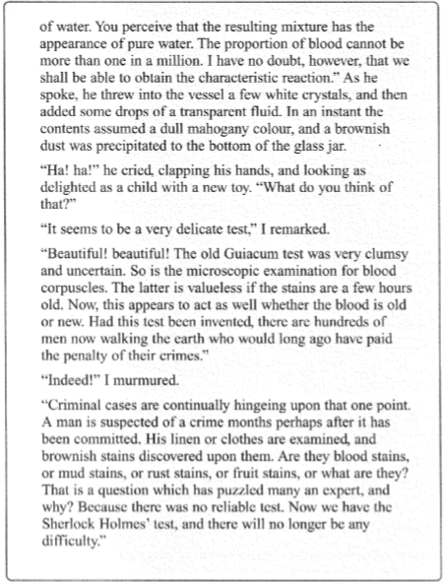

Slide 5
Definitions
Haemoglobin: a constituent part of blood Guiacum Test: a fictional scientific test for blood
Mahogany: a dark brown, woody colour
Precipitated: when a substance is deposited in solid form from a solution (precipitation)
Corpuscles: blood cells
Cordially: warmly or in a friendly way
Bunsen burner: a gas burner used in labs to heat these up
Obtain: to get, receive, acquire or secure

Slide 6
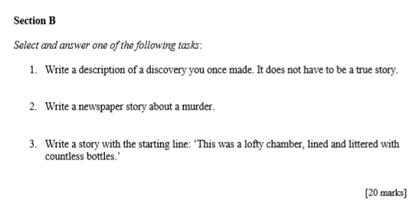

Slide 7
“Write a description of a discovery you made. It does not have to be a real story.”
SEMANTIC FIELD creates an atmosphere
Dark
Mystery
Astounded
Bizarre
Shocking
Sinister
Curiosity
Intriguing

Slide 8
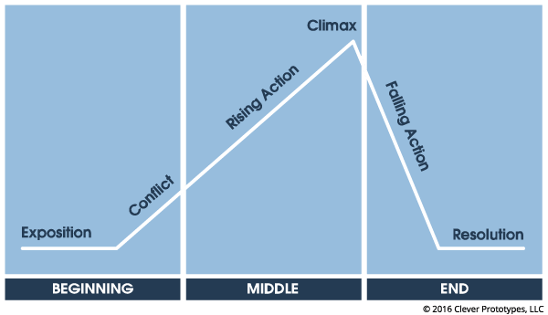
Setting the Scene
Who where when
Denouement

Slide 9
SHOW DON’T TELL
TELLING (explicit) James was very sad because everyone had forgotten his birthday
SHOWING (implicit) James crept down the stairs in the morning eagerly but felt his eyes begin to mist over as he surveyed the empty living room where his presents should have been
Can you make this example of a “telling” sentence into a “showing” one:
“Angie was very excited to start her new school”

Slide 10
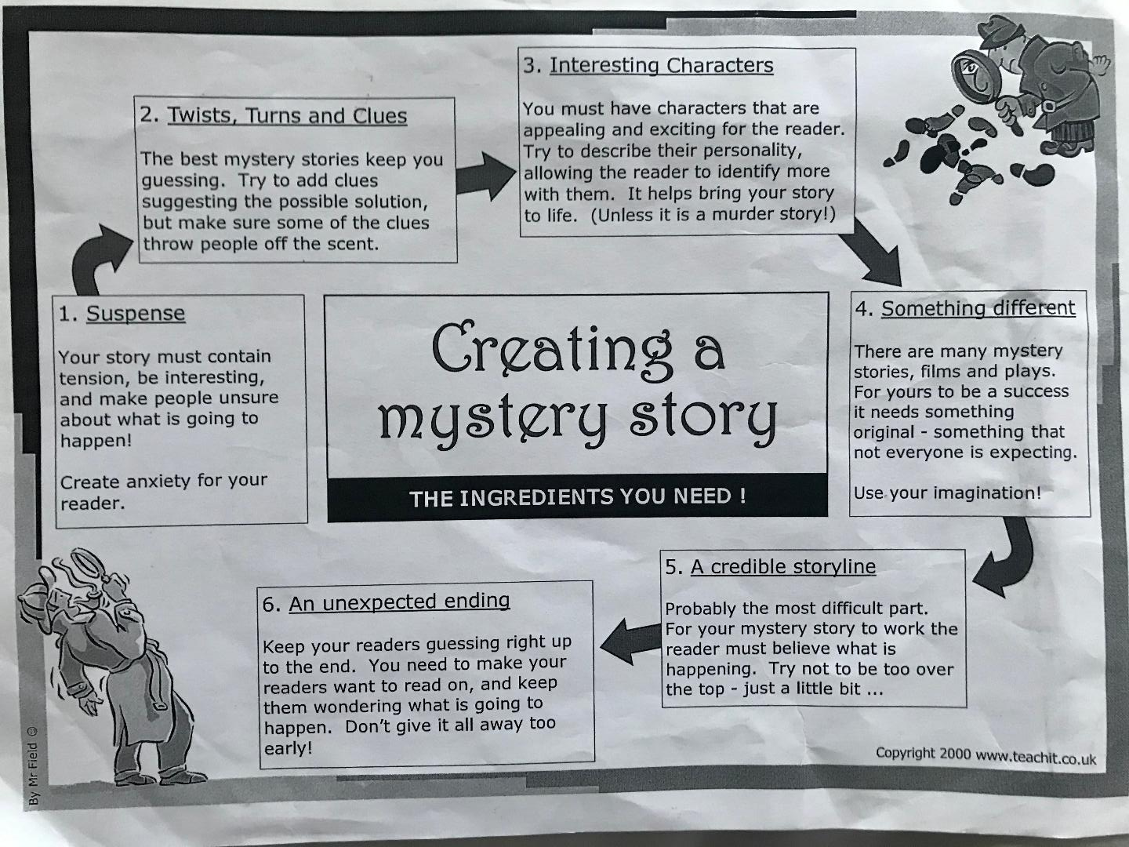
Conventions of mystery writing
Flashback
Foreshadowing
Onomatopoeia
Suspense

Slide 11
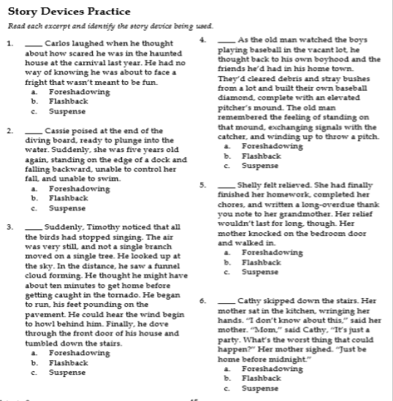
Answers on the next slide

Slide 13
Final Thoughts
What Went Well?
Even Better If?
Homework: Pick one of the questions on the exam paper to complete for homework (if you pick the one we studied in class then you need to make a new plan for it and make sure the story is different). Spend about half an hour on this homework with 5 minutes planning time before, to help you get used to the exam timings. This homework is due on Thursday 2nd July.

